Slide 1

Digital Egypt Pioneers Initiative (DEPI) Oracle EBS ERP
PRESENTATION

Slide 2
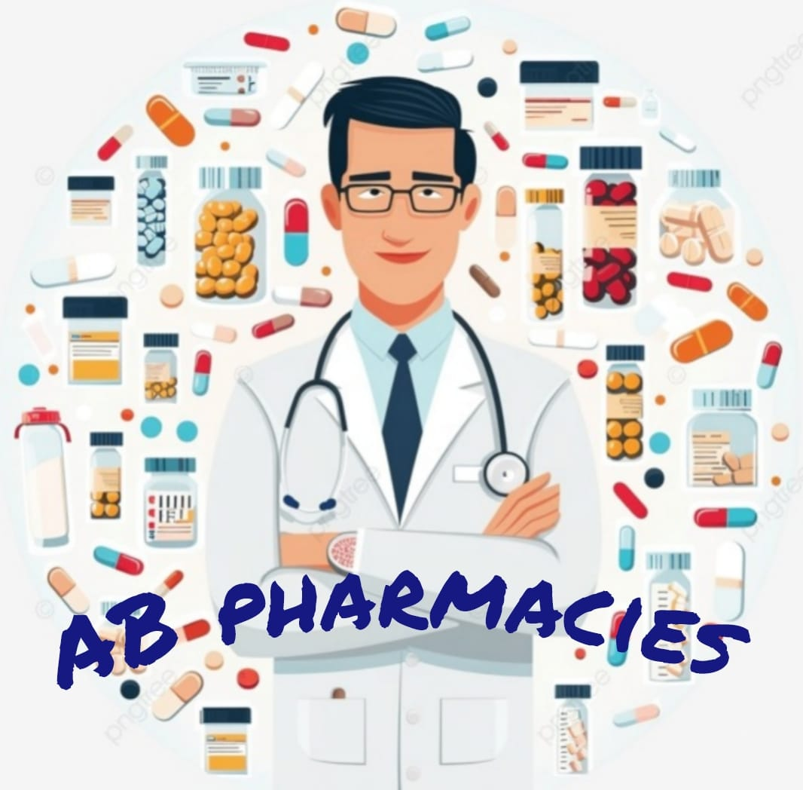
Optimizing of chain of Pharmacies Supply Chain Management with Oracle EBS ERP
PRESENTATION

Slide 3
Project Overview Objective:
This project aims to implement an integrated Supply Chain Management (SCM) solution using Oracle ERP for AB Pharmacies, a leading provider of pharmaceutical products and services. Currently, AB Pharmacies faces challenges in supply chain management, including:
Inventory stock outs and overstocking
Inefficient order processing
Lack of real-time visibility
Difficulty tracking expiry dates
Ineffective costing methods impacting financial accuracy
These issues affect operational efficiency, profitability, and customer satisfaction. The proposed solution will streamline and optimize the entire supply chain from procurement to delivery using Oracle's comprehensive suite of applications.

Slide 4
Project Overview Scope of Work:
Enhance supply chain visibility and agility
Improve inventory management and reduce stock outs
Streamline procurement and order fulfillment processes
Optimize distribution and logistics
Increase operational efficiency and reduce costs
Enhance customer satisfaction
Track and manage product expiry dates
Implement a standardized and efficient costing method for financial accuracy

Slide 5
Project Overview Expected Outcomes:
Configured supply chain modules
Business sustainability and continuity
Operational Efficiency:
Faster decision-making and reduced downtime through automation and centralized data
Cost Savings:
Optimized resource allocation and reduced manual intervention
Customer Satisfaction:
Improved transparency and service levels
Scalability:
ERP will support future growth and evolving market demands

Slide 6
Scope of the Project
This project will focus on the following key areas:
Inventory Management:
Implement Oracle Inventory Management to:
Optimize stock levels
Track inventory movements across pharmacies and warehouses
Manage expiry dates
Minimize stock outs and overstocking

Slide 7
Scope of the Project
Purchasing and Order Management:
Deploy Oracle Purchasing and Order Management to:
Automate procurement.
Manage supplier relationships.
Streamline order placement and fulfillment.
Improve purchase price (cost) using average cost.

Slide 8
Scope of the Project
Inventory Management :
Depending on the complexity of AB Pharmacies' operations, Oracle inventory Management may be utilized to:
Monitor stock levels in the real time.
Track the batches and expiry dates accurately.
Optimizing inventory cost and forecasting.
Manage transfers between warehouses and pharmacies.
Provide detailed inventory reporting.
Integration:
The Oracle SCM solution will be integrated with purchasing and order management.

Slide 9
Scope of the Project
Reporting and Analytics:
Develop custom reports and dashboards using for:
Real-time visibility into supply chain metrics
Data-driven decision-making
Training and Change Management:
Provide comprehensive training to staff on the new Oracle system
Effectively manage the change process to ensure smooth adoption

Slide 10
Ab pharMACIES, MULTI ORG. STRUCTURE

Slide 11
PROJECT PERPOSE
HOW TO CONTROL AND COVER THE SUPPLY CHAIN OF A SERIES OF PHARMACIES AND MANAGING THE SEQUINCE OF WORK INSIDE THE RETAILS STORE AND MAIN WAREHOUSE ?
The project team assume the plan of the work to organize the business as we have , it will consists of :
1 business group , 1ledger , 1legal entity , 1 operating unit .
2 inventory organization ( 1 warehouse (ABW) , 1 retail (ABR)), each one will have 1 hypothetical stage subinventory
Warehouse org. has 2 subinventory (cairo warehouse , upper warehouse).
Retail org. has 5 subinventories (asuit ,benha, cairo ,Alexandria , mansoura ).

Slide 12
MULTI –ORG. STRUCTURE :
BUSINESS GROUP
GENERAL LEDGER
LEGAL ENTITY
OPERATING UNIT
Vision corporation
VISION OPERATION
VISION OPERATION
AB pharmacies ou

Slide 13
MULTI –ORG. STRUCTURE :
OPERATING UNIT
INVENTORY ORG.
SUB INVENTORY
LOCATORS
AB PHARMACIES
WAREHOUSE
(ABW)
RETAIL
(ABR)
UPPER CENTRAL WAREHOUSE
UPPER WH
CAIRO CENTRAL WAREHOUSE
CAIRO WH
BENHA
CAIRO
ASUIT
ALEXANDRIA
MANSOURA

Slide 14
Business CYCLE :
Define the items and assign it to the inventory organizations .
Define the locators, with a locator for expired medicine in each subinventory.
Define the items in general planning to be MIN-MAX to make replenishment from inventory org (ABW) or suppliers.
Define the Picking rule and assign it.
Assign suppliers .
Define shipping parameters between org.

Slide 15
Business CYCLE :
The trade movements are :
RETAILS INVENTORY ORG. :
It will make sales directly with consumers.
It will compensate its levels of stock through Min-Max directly from (ABW) or making internal requisitions up to the administration.
MAIN WAREHOUSE INVENTORY ORG. (ABW) :
It will issue the items to the retails according to its location.
It will receipt items from the suppliers.
return.
Transfer the stock between different warhouses.

Slide 16
Delegation of authority:
Defining the approval group to control the limits of purchasing for each level.
Pharmacy approval hierarchy limits :
CEO (Unlimited)
ABP. General Manager (20,000$)
ABP. Proc. Manager (10,000$)

Slide 17
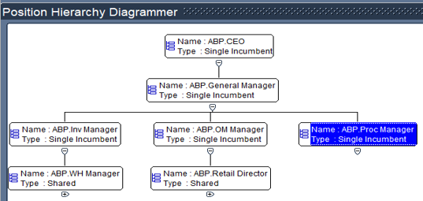
POSTION HIERARCHY

Slide 18
Business flow action

Slide 19
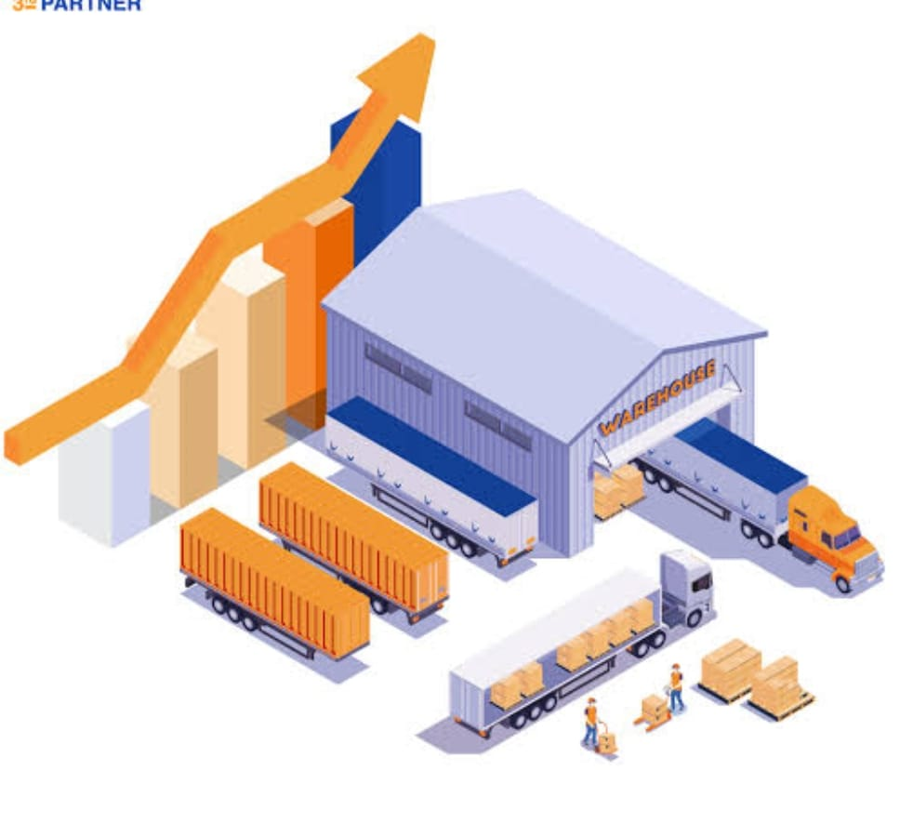
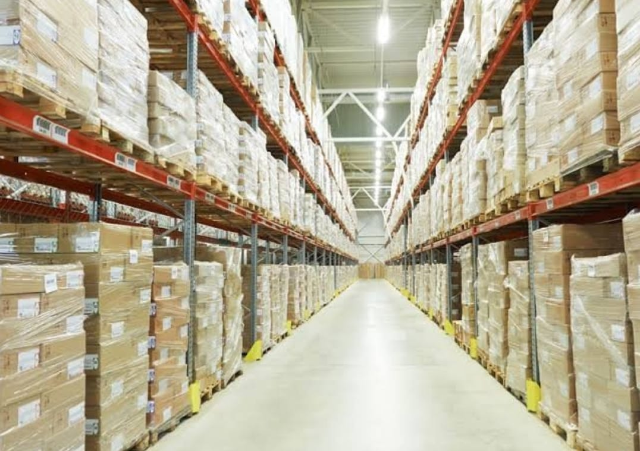

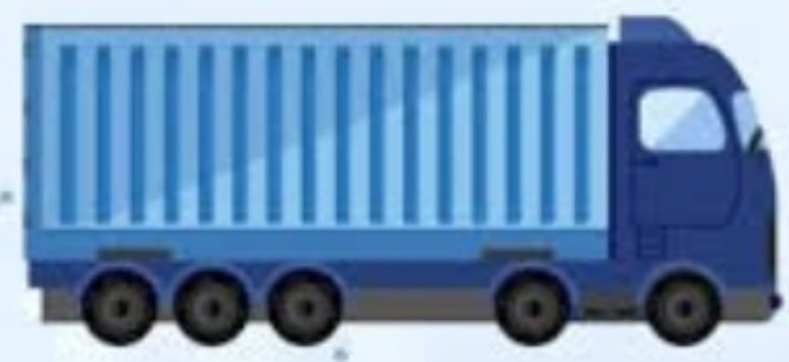
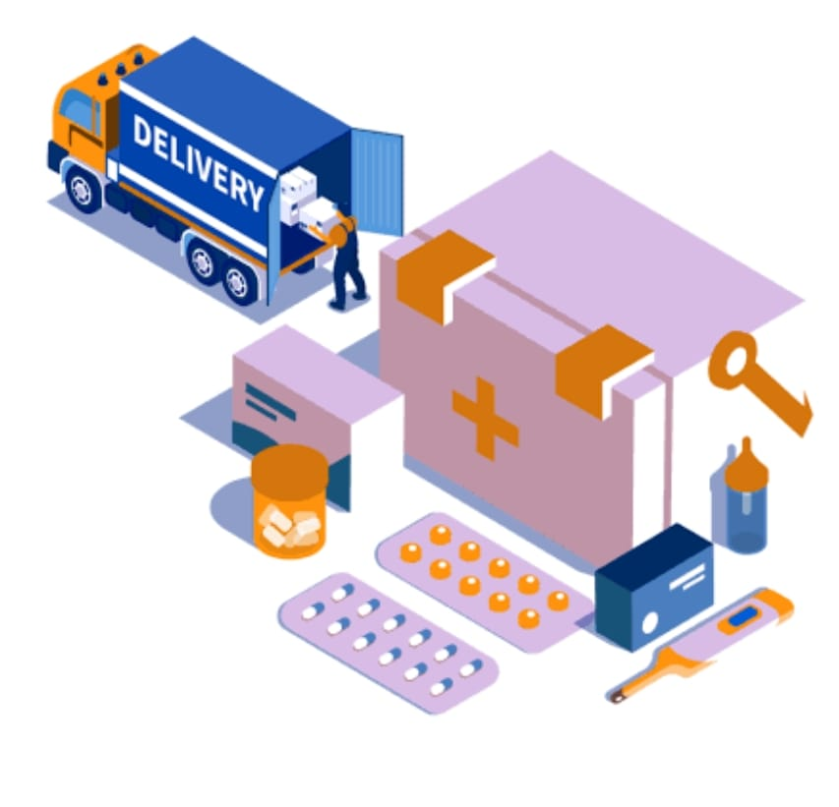
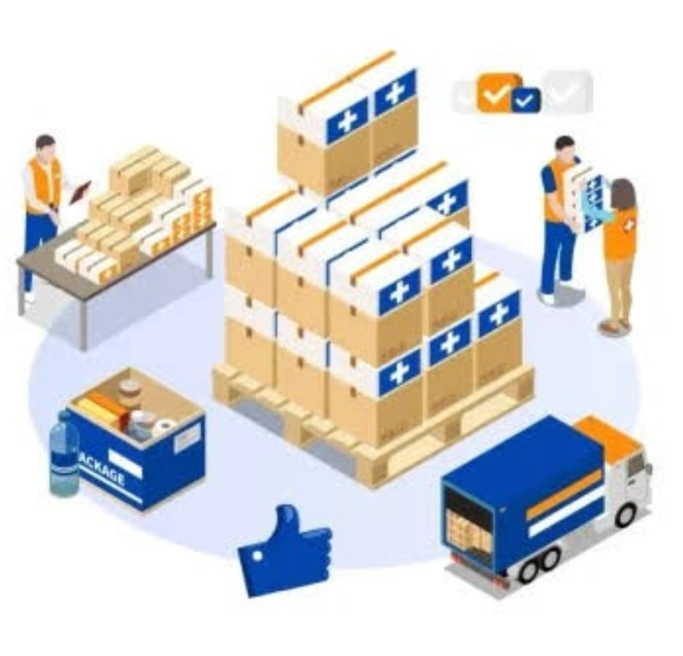

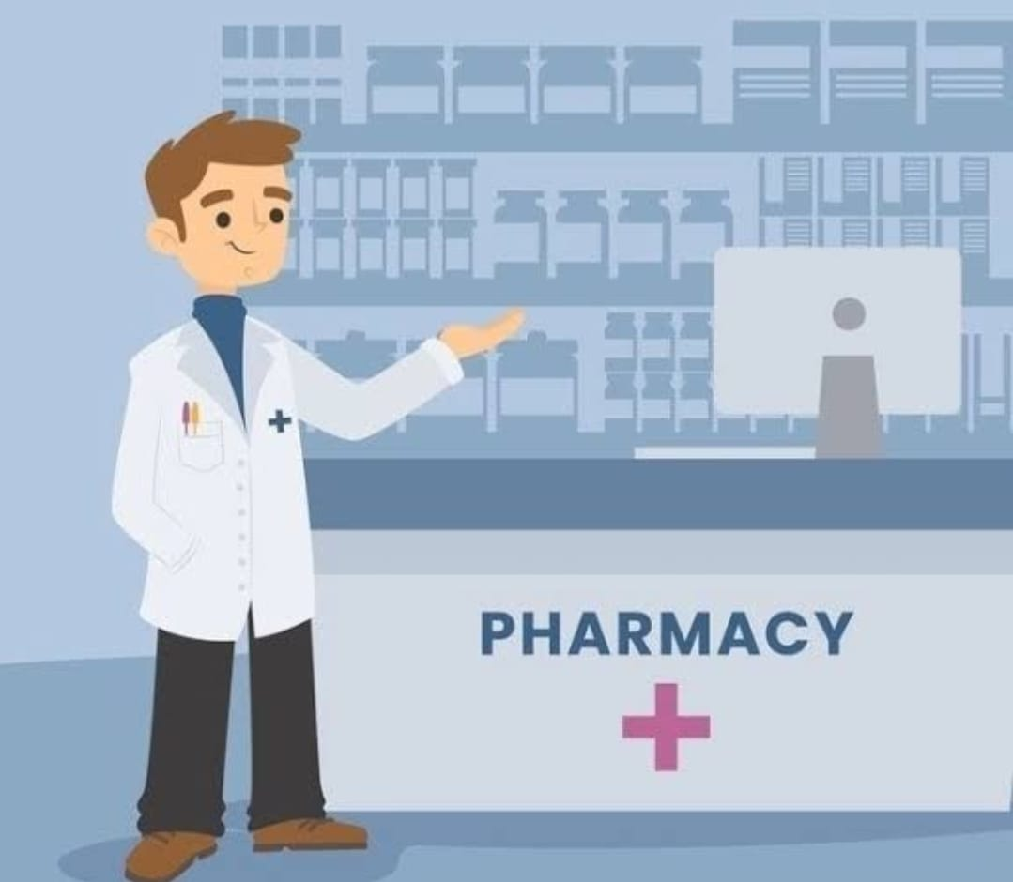
SUPPLIERS
amon
hikma
eva
ABW
Warehouse cairo
Warehouse upper
Asuit retail
cairo retail
Benha retail
RETAILS
Alex. retail
Mansoura retail

Slide 20
Conclusion and Call to Action
Project Summary:
A fully integrated pharmaceutical company with a supply chain that starts at warehouses and ends at retail pharmacies.
Oracle EBS is proposed as the core system to manage operations professionally and efficiently.
Reduction of waste, improved efficiency, and faster workflow cycles.
Call to Action:
We recommend approving the launch of the project according to the proposed timeline.
Begin allocating the necessary resources to establish the infrastructure and activate the system.

Slide 21
A smart investment in the future of harmaceuticals ,
backed by
a solid digital foundation
for success and sustainability.
Are you ready to take the first step ?

Slide 22
Thank you

